Slide 1




A Complete Guide to Programming in C++
Chapter 20 – Type Conversion for Classes

Slide 2

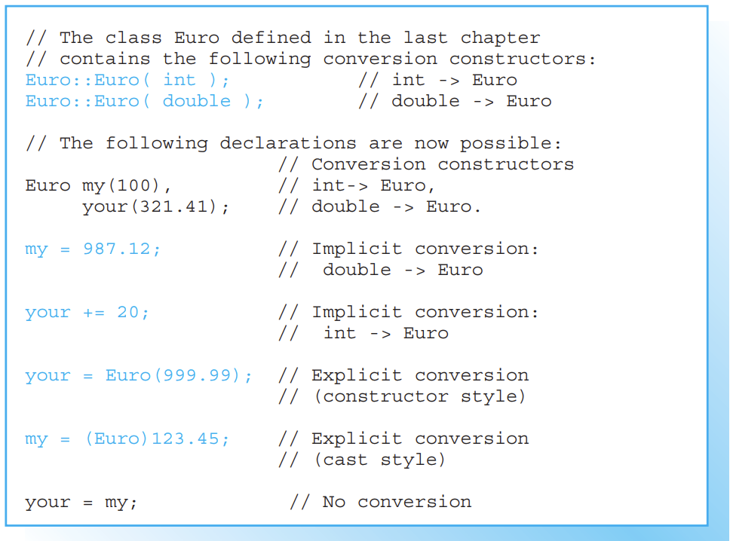

Type Conversion for Classes
Implicit type conversion occurs in C++ when an expression cannot be compiled directly but can be compiled after applying a conversion rule. The programmer can stipulate how the compiler will perform implicit type conversion for classes by defining conversion constructors and functions

Slide 3
Possible Type Conversions
Implicit and explicit type conversion is also performed for classes in C++. As a programmer, you decide what kind of conversion is permissible. You can allow type conversion between different classes or between classes and fundamental types.
Any type conversion involving a class is defined either
by a conversion constructor
by a conversion function.
A conversion constructor performs type conversion by converting any given type to the type of the current class. A conversion function performs conversion in the opposite direction, that is, it converts an object of the current class to another type—a standard type, for example.

Slide 4
Conversion Constructors
A constructor with a single parameter determines how to form an object of the new class from the argument passed to it. For this reason, a constructor with only one parameter is referred to as a conversion constructor. The copy constructor is an exception to this rule: it creates an object of the same class and does not perform type conversion.
Each conversion constructor is placed by the compiler on a list of possible conversions. The standard string class contains a constructor that creates a string object from a C string, for example.
This allows you to supply a C string as an argument wherever a string object is required.

Slide 5
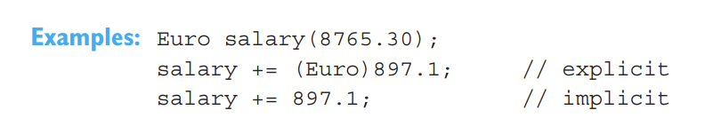
Calling a Conversion Constructor
Conversion constructors have already been used in several examples; for example, in the Euro class. The compiler uses them to perform implicit and explicit type conversion.
The last statement initially causes a type mismatch. Addition is not defined for a euro and a double value. The compiler therefore activates the conversion constructor to create a temporary Euro type object from the double value. This object is then added to the value of the salary object.

Slide 6
Conversion functions
If you need to convert an object of the current class to another type, you must define a conversion function to do so. This is an operator function that defines how conversion is performed. Conversion functions are also automatically used by the compiler to perform implicit and explicit type conversion.

Slide 7
https://www.youtube.com/watch?v=zRZLwzoQ1Fo

Slide 8
What is the difference between class and struct?
Everything we do in a struct is public on default
Everything we do in a class is private on default
Examples...

Slide 9
Dynamic memory allocation
https://www.youtube.com/watch?v=wopESdEVJs4

